Slide 1
Connected Health, Patient Co-Design and Paediatric Cancer: Using Acceptance and Commitment Therapy to Support Parental Psychological Flexibility
Emma Delemere & Rebecca Maguire

Slide 2
Disclosures (support example):
Emma Delemere
Relevant Financial Relationships:
This presentation has emanated from research conducted with the financial support of Science Foundation Ireland under Grant number 18/CRT/6222
Relevant Nonfinancial Relationships:
None
Rebecca Maguire
No relevant financial or nonfinancial relationships to disclose

Slide 3
Emma Delemere
Introduction
Department of Psychology, Maynooth University
Doctoral Researcher - ADVANCE CRT
Emma.delemere.2020@mumail.ie

Slide 4
Overview
Needs of families impacted by Paediatric Cancer
Role of ACT
Broader Research Project
Public and Patient Involvement in Intervention Development
Self-directed Online ACT for Parents Of Children With Cancer
Lessons Learnt

Slide 5
Learning Objectives
Participants will learn how connected health can be used to support ACT delivery
Participants will learn how ACT can support parenting burden and wellbeing for parents of children with cancer
Participants will consider the role of self-as-context, cognitive diffusion, committed action and acceptance in supporting wellbeing and parenting burden for parents of children with cancer.

Slide 6
Prevalence of Paediatric Cancer
81%
5 year survival
Increased
Diagnosis
218
More
Long Term Survivors
Effective
Treatments

Slide 7
Secondary Impacts of Paediatric Cancer
Childhood cancer survivors are more likely to:
Social
Challenges
Underemployed
Hospitalised
Health Impacts
Struggle Academically
Mental Health
Impacts
Poverty

Slide 8
Impact on Caregivers
Parental Impact
Emotional, logistical and financial impacts
Significant impact on parent socio-economic wellbeing
Families are unlikely to seek outside support
Parental dual role
Emotional strain
27% experience clinical levels of psychological distress
Higher fear of recurrence

Slide 9
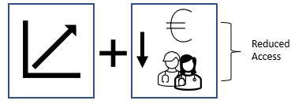
Resulting Service Limitations
?
Connected Health
Resources as limited
Resources as limited
Efficiencies needed to facilitate access to supports
Health care digitalisation
Reduced Access

Slide 10
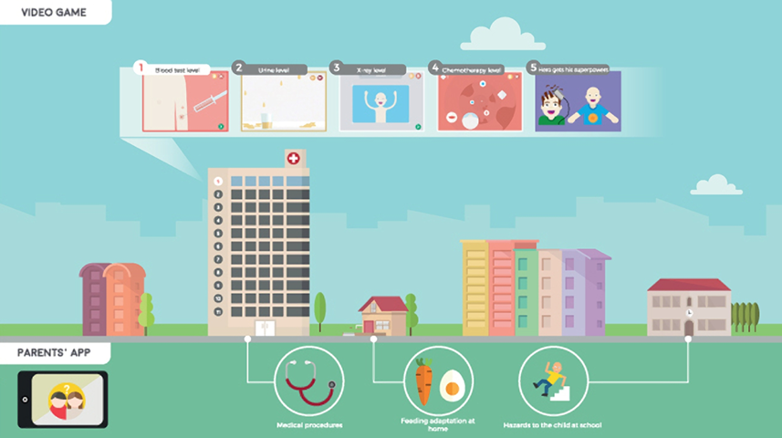
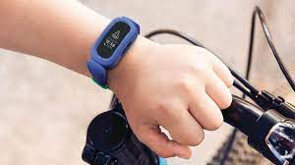
What is Connected Health?

Slide 11
Broader Research Project
What do we know?
What Barriers and Facilitators impact CH use?
What are the needs and challenges experienced by families?
What type of supports do families want?
ACT Intervention
Systematic Review
Digital Divide
Unmet needs
Stakeholder input into development
Content Analysis
Prerequisite Skills- Technology skills, access and eHealth literacy k
Barriers to service access?
PPI

Slide 12
Learnings arising
Significant travel and time burdens
Usability and acceptance
Need for accessible psychosocial supports
Particularly for parents/caregivers
Particularly around transition points
Particularly to support self-efficacy
Aim: Explore the impact of brief online self-directed Acceptance and Commitment Therapy on psychological flexibility, parenting experience and wellbeing for parents of children with cancer.

Slide 13
ACT and Paediatric Cancer
Focus on adjustment and coping
Current Psychological Supports
Lack long term effectiveness
Too limited a scope
Over-focus on psychopathology
Psychological Flexibility as a Protective factor for family coping (Van Schoors et al., 2019)
Psychological Flexibility
Being
Present
Opening
Up
Doing what matters

Slide 14
Why ACT?
Past Research
Children with cancer
Supporting pain management (Cederberg et al., 2017)
Reducing anxiety and depression (Ander et al., 2017)
Supporting recovery from brain tumours (Malins et al., 2021)
Parents of children with medical conditions (Han et al., 2020; Parmar et al., 2019)
Limited analysis for parents of children with cancer
Take A Breath (Muscara et al 2020)
39.5% were parents of children with cancer
Positive effects on post-traumatic stress

Slide 15
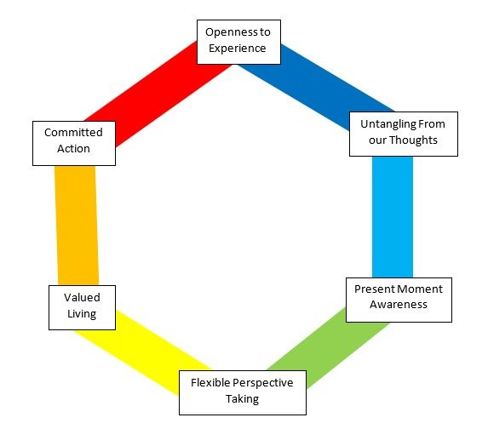
ACT and Paediatric Cancer
However
Time as a valuable resource
Parental time pressure
Efficient & effective supports key
What matters?
Limited analysis
Absence of mediational analysis of processes of change for online interventions

Slide 16
Developing the Intervention
Intervention Proposal
PPI Input:
Aims & form
Initial Intervention developed
PPI input
Revision
Stakeholder (HCP) input
Final version
Pilot
PPI panel assembled
PPI Feedback on results

Slide 17
Designing the Intervention:
Patient and Public Involvement (PPI)
Research carried out ‘with’ or ‘by’ members of the public rather than ‘to’, ‘about’ or ‘for’ them
Participation
Engagement
Involvement
‘with’ or ‘by’ NOT ‘to’, ‘about’ or ‘for’

Slide 18
Why include PPI?
Relevant Research Questions
Accessible
Identify
Confounds
Reflect Needs
Feasibility
Identify Barriers
Acceptability & Trust
Dissemination and Impact

Slide 19
PPI Approach
Recruitment
Childhood cancer groups
Social media
Snowballing approach
Flexible form
Minimise burden
Included
Focus Group
Individual feedback session
Email/written feedback

Slide 20
PPI Initial Session
Something to prompt you to see the positive
Something you could pick up and practice when you need it
Aim:
Presented project findings
Explore what an intervention might address/be
Key Findings:
Psycho-social needs currently unmet
Inaccessible
Costly
Difficult to prioritise
Highly heterogenous group
Time as a valuable resource
Not scheduled/committed
Short and segmented
Usability key
Acceptance and Commitment Therapy - ’reframing thoughts’
Initial hesitation - Terminology
Short, ‘tap-able’ exercises
Anything that requires set times or long sessions would be too difficult

Slide 21
PPI Session 2 – October 2021
Revisited panel with an intervention design arising from suggestions given.
Focus group = 2 attendees
Written/email feedback = 2 attendees
How best do we do this?
How do we help those who use the tool keep using it?
How to incentivise use?

Slide 22
PPI Session 2 – October 2021
Key Findings
Positive feedback on design
Accessibility and Usability Key
Need to be mindful of terminology
Parenting ‘burden’ unpreferred
‘mindfulness’ unpreferred
Tasks and surveys should be short to reduce attrition
Dissemination - a trusted source

Slide 23
Stakeholder Feedback – Health Care Providers
Presented updated intervention to Paediatric Cancer MDT meeting
Feedback on design, usability and aims
How best to support access across patient groups
Key Findings
Positive feedback on design
Consider different needs at different stages
Collaboration on recruitment

Slide 24
Based on this: This project
Online self-directed Acceptance and Commitment Therapy Programme for parents of children with cancer
To support:
Psychological flexibility
Parenting experience
Mental wellbeing

Slide 25
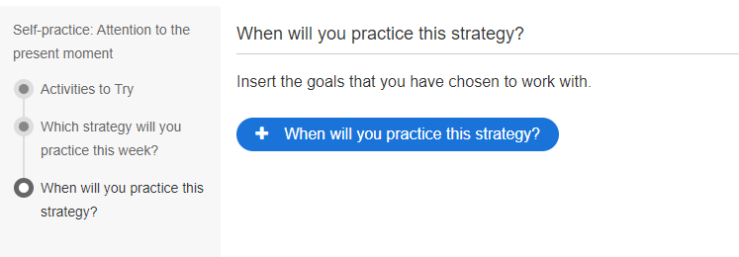
Based on this: This project
ACT Intervention
6 weekly sessions each themed around an individual aspect of the Hexaflex
Self-directed
Sessions available weekly
Email prompt
Each week includes
An introduction to the topic
Metaphors
Experiential exercises
Suggested tasks to practice
Information will be presented in a variety of formats
The intervention provided using Moodle

Slide 26
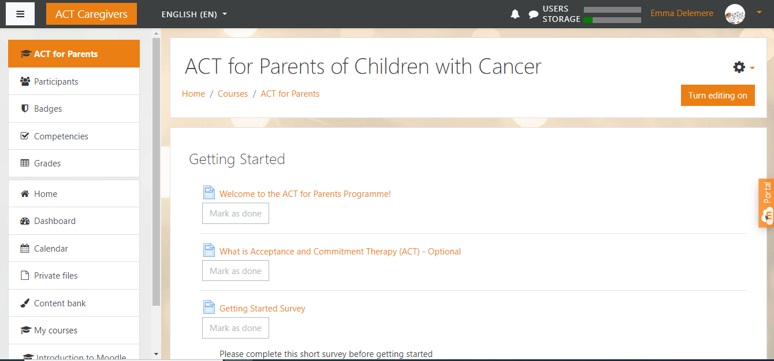
PPI Session 2 – October 2021
ACT Intervention
6 weekly sessions each themed around an individual aspect of the Hexaflex
Self-directed
Sessions available weekly
Email prompt
Each week includes
An introduction to the topic
Metaphors
Experiential exercises
Suggested tasks to practice
Information will be presented in a variety of formats
The intervention provided using Moodle

Slide 27
Research Question
1. Examine the effects of an online self-paced ACT intervention for parents of children with cancer on psychological flexibility, parental burden and mental wellbeing.
Promising role for ACT
Limited research considering its use for parents of children impacted by paediatric cancer
Significant travel and time burdens
Need accessible psychosocial supports which do not pose further burden
Role of CH
Efficacy of online self-directed ACT unknown
2. Explore the impact on specific aspects of psychological flexibility - Self-as-context, cognitive diffusion, committed action and acceptance
3. Determine if online supports facilitate for families who experience burden accessing traditional supports through analysis of acceptance and attrition

Slide 28
Procedure
Screening and Consent
Pre-Intervention Survey
Post-Intervention Survey
Follow-up survey
(I month)
Assignment to Experimental Group
(If RCT)
ACT intervention.
If pre/post design (<54 participants)
Demographic Information
Parent Psychological Flexibility Questionnaire
The Self-as-Context Scale
WHO Well-Being Index 5-items
Brief Parental Burnout Scale
Demographic Information

Slide 29
Lessons Learnt & Next Steps
Leave time for PPI processes
Representative groups difficult/adding burden
Hospital ethics – Slow
Available to parents attending the Children’s Cancer ward/out-patient service shortly
Results expected by September

Slide 30
Connected Health, Patient Co-Design and Paediatric Cancer: Using Acceptance and Commitment Therapy to Support Parental Psychological Flexibility
Thank you for your attention
Questions?
Emma Delemere & Rebecca Maguire

